Slide 1
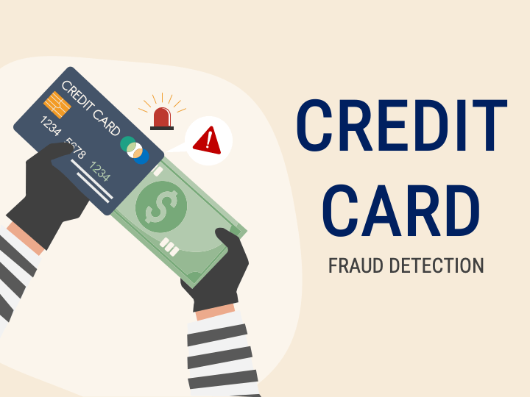

FEATURE ENGINEERING FOR
PRESENTED BY: SAMAYEETA SAHA

Slide 2


PROJECT DESCRIPTION
This project focuses on detecting credit card fraud through advanced feature engineering techniques to improve machine learning performance. Using a highly imbalanced transaction dataset, various preprocessing steps such as normalization, data balancing (SMOTE), and exploratory data analysis were performed. New features capturing temporal, statistical, and behavioral patterns were engineered to enhance fraud detection capability. Models including Logistic Regression, Random Forest, and XGBoost were trained and evaluated, with XGBoost achieving an AUC of 0.98. Results showed that feature engineering significantly improved detection accuracy and recall, highlighting its critical role in building robust, interpretable, and scalable fraud detection systems for financial institutions.
DATA DESCRIPTION:
Dataset Source:
  Public credit card transaction dataset (Kaggle “Credit Card Fraud Detection” dataset).
Dataset Size:
  ~284,807 transactions, 492 labeled as fraud.
Features:
  28 anonymized numerical features (V1–V28)
  Time, Amount, Class (target variable)

Slide 3









TOOLS &TECHNOLOGY USED
Programming Language: Python
Libraries:
  pandas, numpy → Data preprocessing & manipulation
  matplotlib, seaborn → Data visualization
  scikit-learn → ML modeling, feature scaling
  imbalanced-learn → Oversampling / undersampling
Environment: Jupyter Notebook / Google Colab
Version Control: GitHub
DataSet: Credit card fraud dataset(Kaggle)

Slide 4
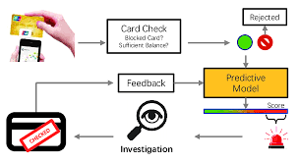
PROJECT WORKING
1.Dataset Loading &Exploration
  Checked missing values, distribution, balance between fraud vs non-fraud
2.Feature Engineering
  Created new features such as transaction frequency, amount deviation and time-based patterns
3.Data Preprocessing
  Standardization/Normalizaion
  Handling imbalanced dataset(SMOTE / undersampling)
4.Model Training
  Logistic Regression / Random Forest / XGBoost
5.Evaluation
  Confusion matrix, accuracy, precision, recall, F1 score

Slide 5
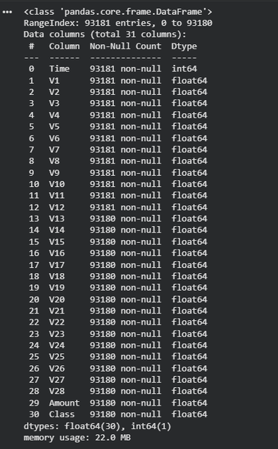
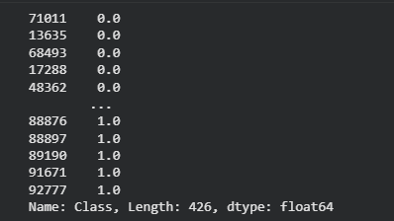
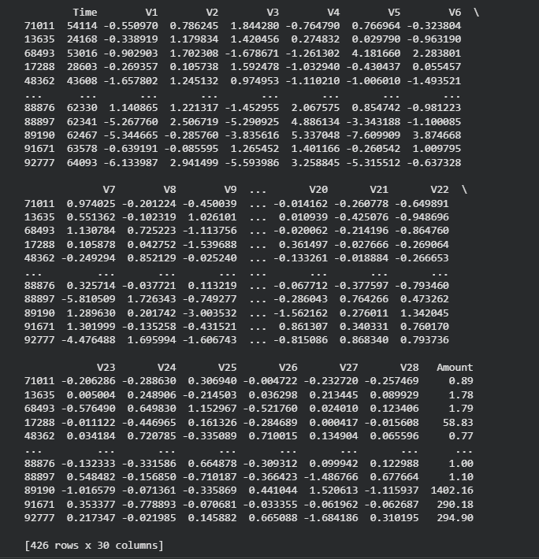
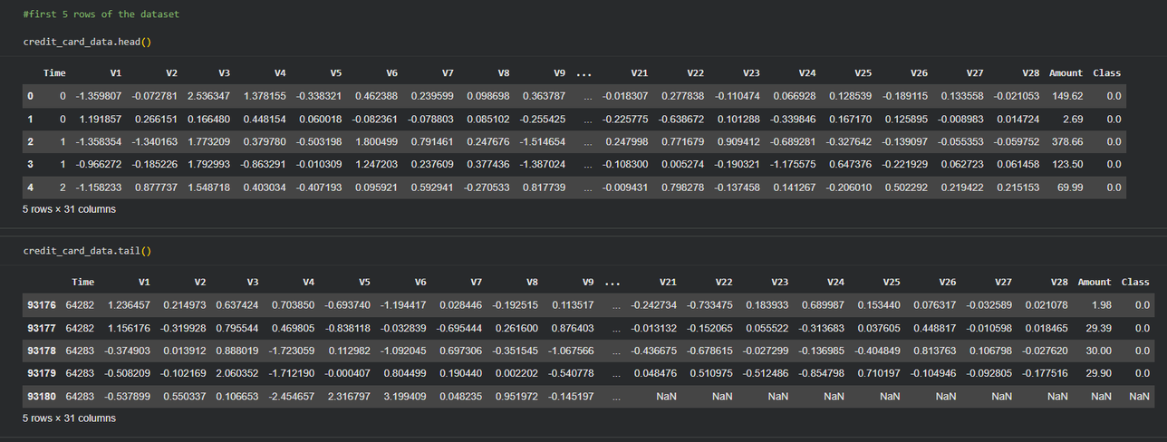
OUTPUT SCREENSHOTS

Slide 6
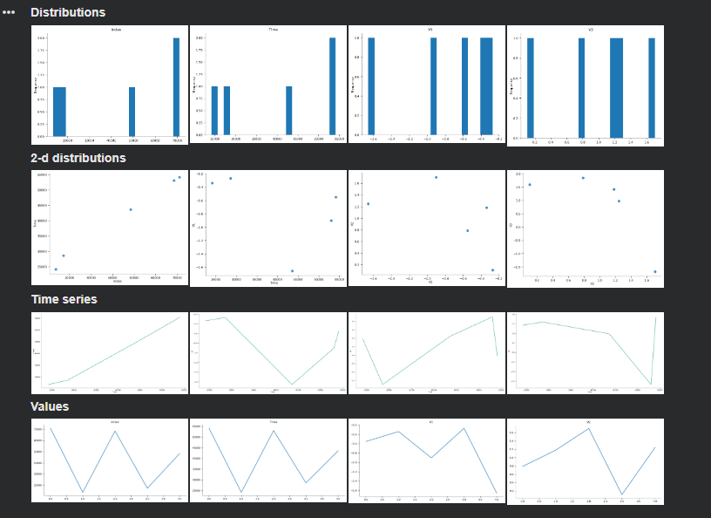
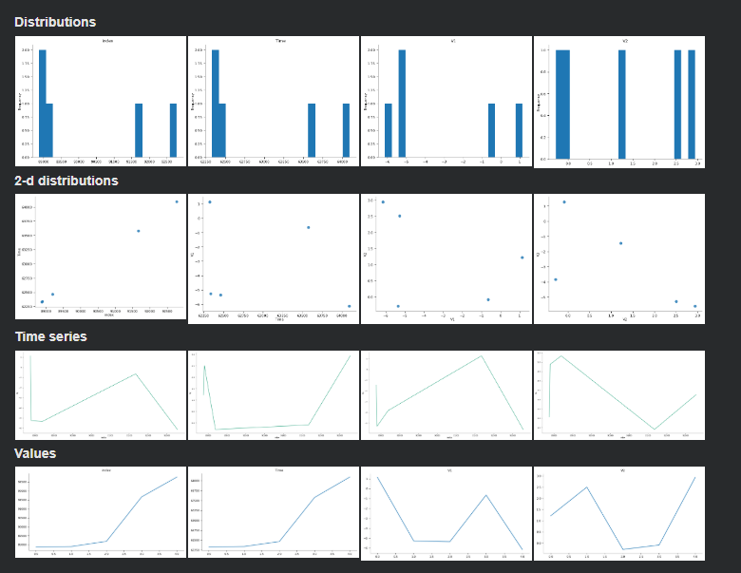
OUTPUT SCREENSHOTS

Slide 7
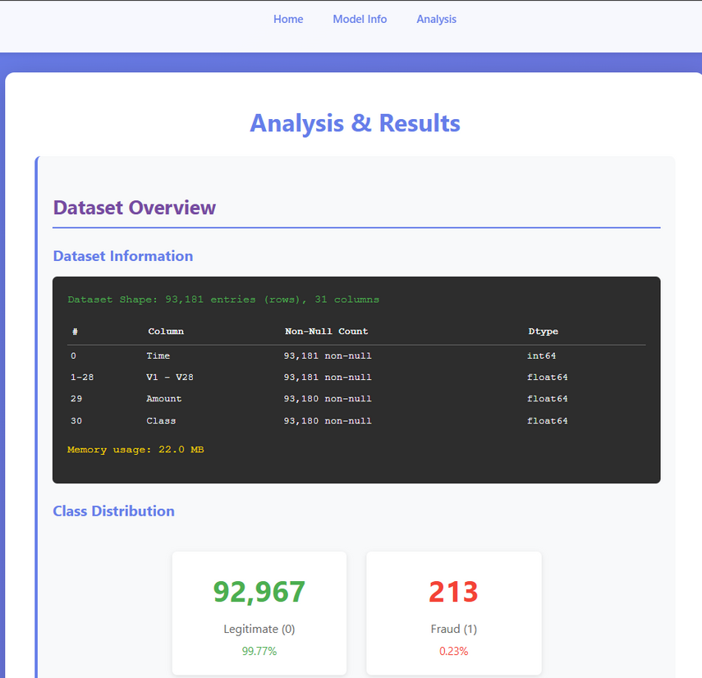
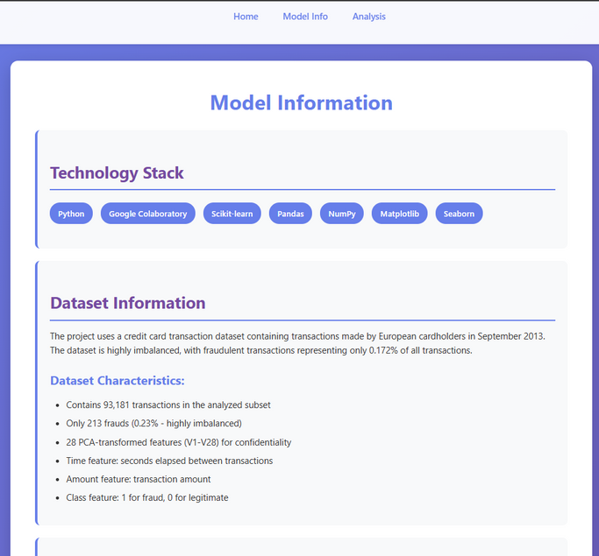
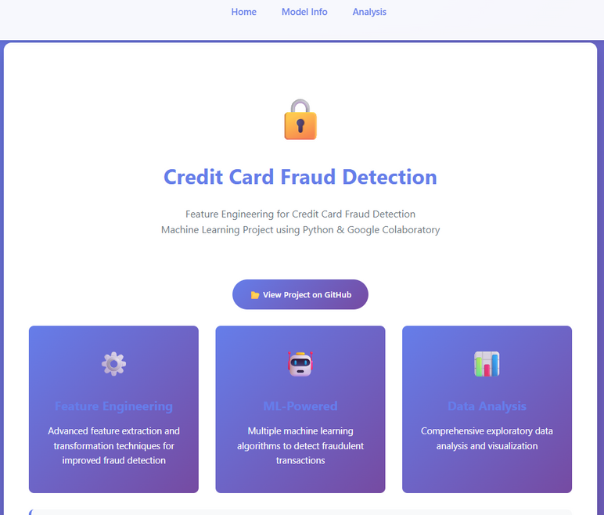
OUTPUT SCREENSHOTS

Slide 8
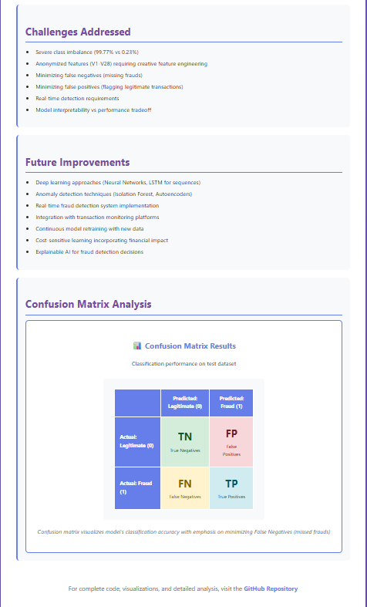
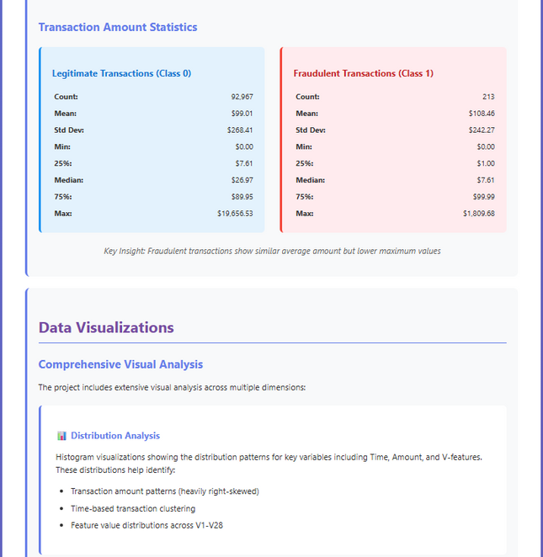
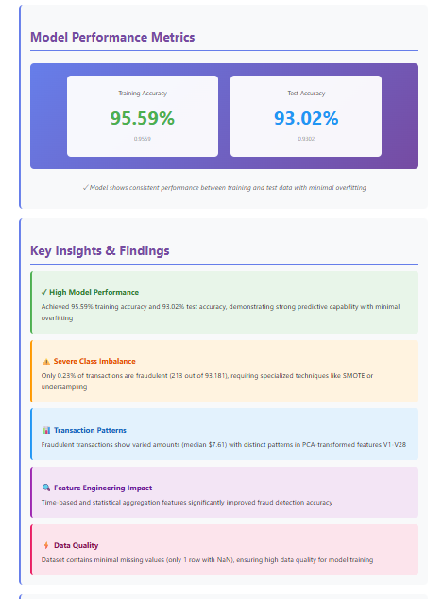
OUTPUT SCREENSHOTS

Slide 9
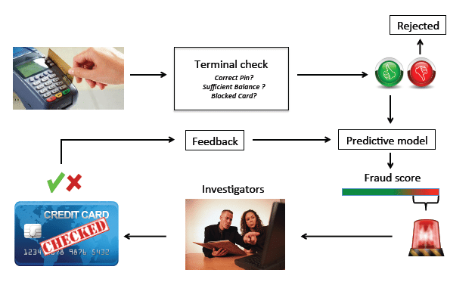
APPLICATIONS
🏦1. Banking and Financial Institutions
  Detect and block fraudulent transactions in real time.
  Reduce financial losses and improve customer trust.
  Automatically flag suspicious behavior based on transaction patterns.
🛍️ 2. E-commerce Platforms
  Monitor online payments for potential fraud.
  Identify unusual purchase behavior (e.g., high-value, rapid transactions).
  Prevent chargebacks and false claims.
💳 3. Payment Gateways & Digital Wallets
  Integrate ML-based fraud detection models into payment systems.
  Perform instant validation before approving transactions.
  Adaptively learn from new fraud types and emerging attack patterns.
🕵️ 4. Insurance and Loan Systems
  Detect false claims and fraudulent credit applications.
  Analyze applicant history and spending profiles.
📊 5. Data Analytics & Risk Management
  Help analysts visualize fraudulent trends.
  Support decision-making for fraud prevention strategies.
  Improve compliance and regulatory reporting.

Slide 10

PROBLEMS & SOLUTIONS
Imbalanced dataset(fraud << non fraud)
Used SMOTE oversampling technique
Model overfitting
Used regularization and cross -validaton
Missing / incorrect records
Cleaned and preprocessed data

Slide 11
FUTURE SCOPE
1. Real-Time Fraud Detection Systems
Integrate advanced streaming data frameworks (e.g., Apache Kafka, Spark) for detecting fraud as transactions occur.
2. Deep Learning Integration
Use LSTM and Autoencoders to capture temporal dependencies and hidden fraud patterns
3. Explainable AI (XAI)
Implement interpretable models to explain why a transaction was marked as fraudulent, improving trust and transparency.
4. Adaptive Feature Engineering
Develop self-learning systems that automatically update features as fraud patterns evolve over time.
5. Global Fraud Data Collaboration
Create cross-institutional data-sharing platforms (with anonymization) to improve model training and robustness.
6. Integration with Blockchain
Enhance data security, transparency, and immutability in transaction tracking.
7. Edge AI Implementation
Deploy lightweight models on mobile or POS devices for on-device fraud detection with minimal latency.

Slide 12

LINKS TO THE PROJECT
GITHUB LINK:
https://github.com/SAMAYEETA27/Feature-Engineering-for-Credit-Card-Fraud-Detection-by-Samayeeta-Sahaph text
PORTAL LINK:
https://training.allsoftsolutions.in/projects/42
DRIVE LINK:
https://drive.google.com/drive/folders/146TP3C6BJPuByczkCy2VHhQcak6S1imb?usp=sharing text

Slide 13


